Slide 1

W E L C O M E

Slide 2

MY PROFILE
Biddut Khoshnobish
Assistant Teacher
Sristy Residential School Tangail
Cell: 018 3311 6567
E-mail: biddut.khoshnobish@gmail.com

Slide 3
Subject
English For Today
Class IX-X

Slide 4
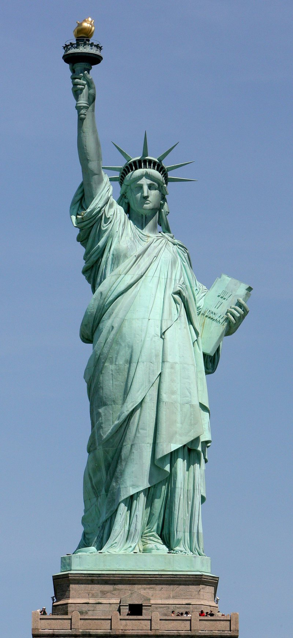
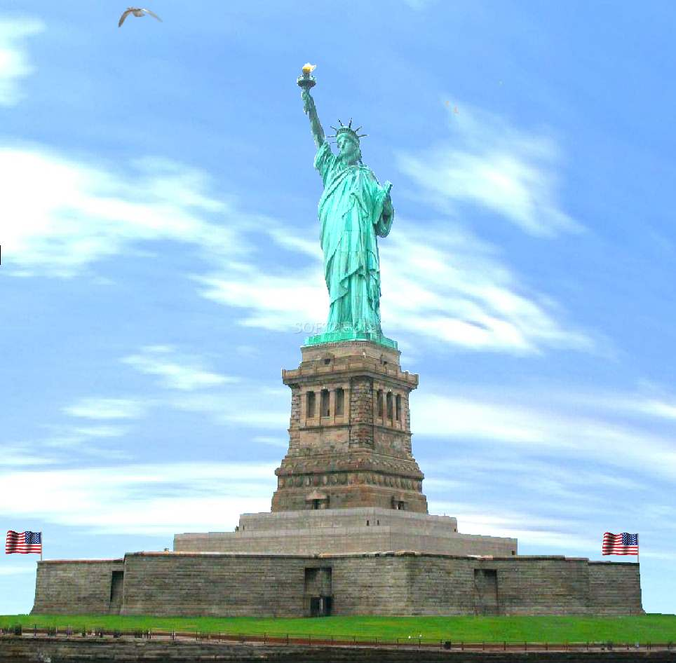
Can you recognize these?

Slide 5
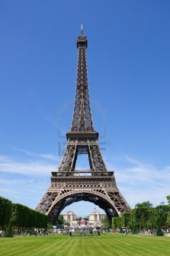
Or
Can you recognize it?

Slide 6
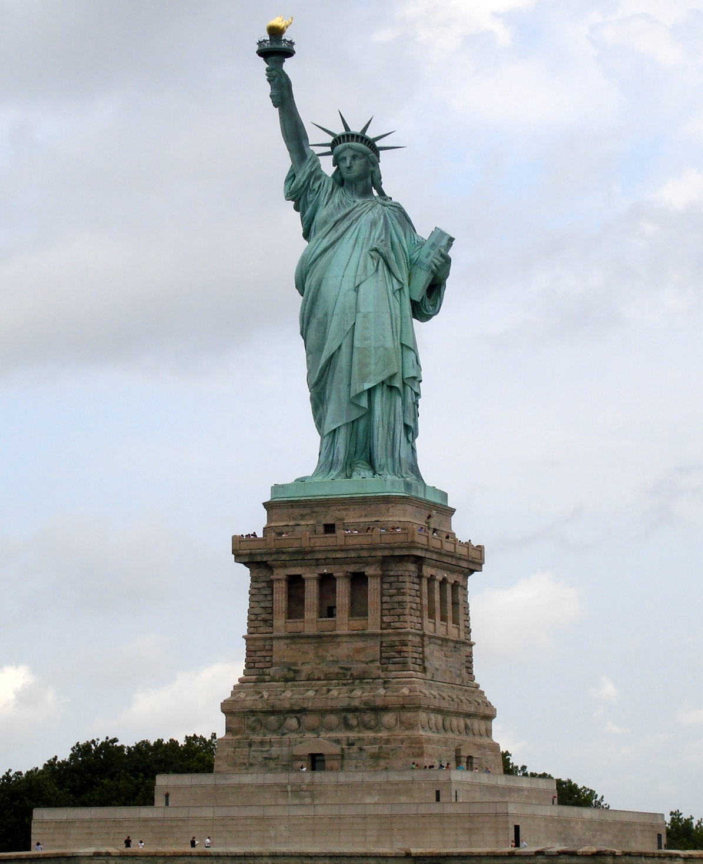
The Statue of Liberty
New York, USA

Slide 7
Eiffel Tower, Paris, France
AvB‡dj UvDqvi
B‡dj UvDqvi
Designer:
Gustave Eiffel

Slide 8
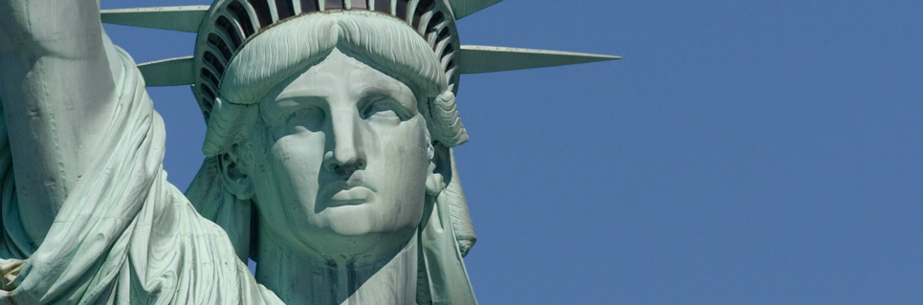
Unit 8: World Heritage
Lesson 3: The Statue of Liberty

Slide 9
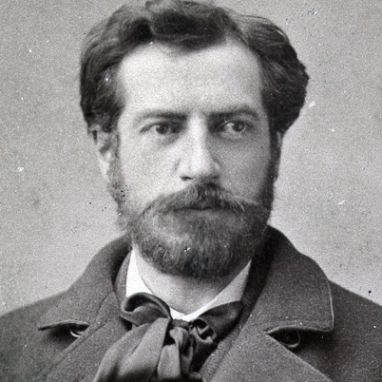
The Designer
Of
The Statue
Frederic Auguste Bartholdi

Slide 10
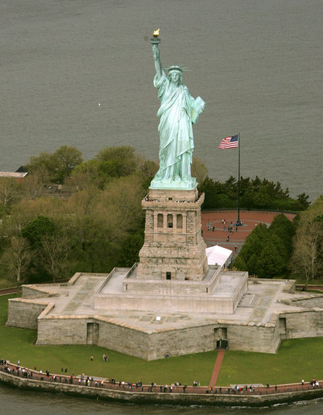
The Pedestal

Slide 11
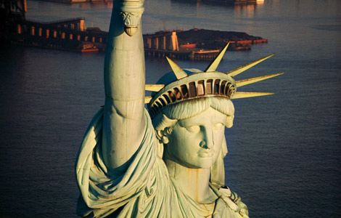
Man
or Woman?
Woman
Libertas,
Roman goddess of freedom

Slide 12
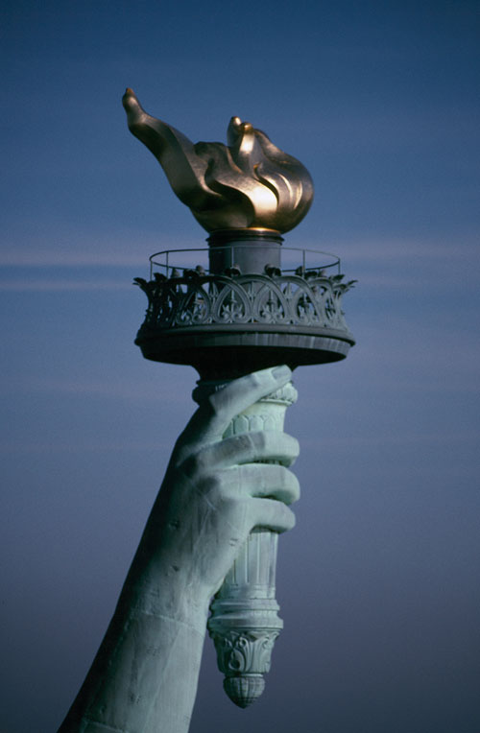
The Copper Torch
Covered in gold

Slide 13
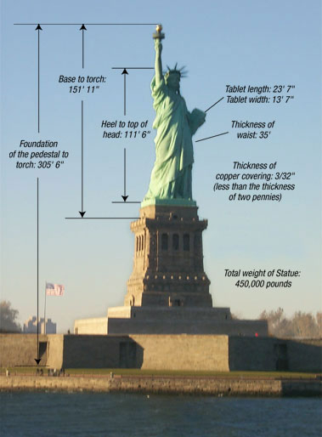
Measurement

Slide 14
Physical Characteristics
Feature | U.S. | Metric
Height of copper statue | 151 ft 1 in | 46 m
Foundation of pedestal (ground level) to tip of torch | 305 ft 1 in | 93 m
Heel to top of head | 111 ft 1 in | 34 m
Height of hand | 16 ft 5 in | 5 m
Head thickness from ear to ear | 10 ft 0 in | 3.05 m
Distance across the eye | 2 ft 6 in | 0.76 m
Length of nose | 4 ft 6 in | 1.48 m
Right arm length | 42 ft 0 in | 12.8 m
Width of mouth | 3 ft 0 in | 0.91 m
Tablet, length | 23 ft 7 in | 7.19 m
Tablet, width | 13 ft 7 in | 4.14 m
Tablet, thickness | 2 ft 0 in | 0.61 m
Height of pedestal | 89 ft 0 in | 27.13 m
Height of foundation | 65 ft 0 in | 19.81 m

Slide 15
Learning Outcomes
History and information of The Statue of Liberty
Importance of the statue
Brief discussion about the pictures
Synonyms
Fill in the gaps
Information Transfer

Slide 16
Statue of Liberty | Information
Situated | Ellis Island, In the harbour of New York, Manhattan, USA
Artist | Frederic Auguste Bartholdi, France
Gift from | France
Reason for the gift | friendship
Presented on the occasion | American Independence
The statue symbolizes | Freedom, Enlightening the world, Forward Movement
Frame work made of | Iron but covered with copper
Amount of copper used | 27.22 tonnes
Weight | 204.1 tonnes
Year of UNESCO World Heritage site | 1984
Gender | Female, Libertas, Roman Goddess of Freedom

Slide 17
Synonyms
Assigned | Appointed
Sculpture | Model
Declaration | Proclamation/Announcement/ notification
Independence | Liberty/freedom/autonomy/separation
Venture | Enterprise/ investment/project
Pedestal | Podium/ base/ foundation
Statue | Effigy/ image/ sculpture
Centennial | Hundredth/ 100th
Enlighten | Illuminate/ civilize
Lobby | corridor/ hall/ passage
Ultra | Excessive/ too much
Tablet | Book/ notebook

Slide 18
Answer the following questions
a) What does the statue symbolize?
Ans: The statue symbolizes liberty in the form of a woman.
b) What do the torch and the book symbolize?
Ans: The torch symbolizes the light of freedom and the book symbolizes knowledge and the rule of law.
c) What is the Statue of Liberty originally called?
Ans: The Statue of Liberty is originally called ‘Liberty Enlightening the World’.
d) What is the National Monument of the USA?
Ans: The statue, the island and nearby Ellis Island are a National Monument of the USA.
e) What does the statue mark standing in the harbour of New York?
Ans: Standing in the harbour of New York, the statue marks the arrival of millions of immigrants to the United States.

Slide 19
Fill in the gaps with appropriate words
Prominent French artist Frederic Bartholdi was assigned to --------------------- a sculpture as a gift for the Americans. He designed and completed the sculpture as a --------------------- of freedom of Mankind. The copper image was made in the form of the Roman goddess Libertas who would carry a torch and a ------------------ of law. The work was a joint venture. The French built the body and the USA built the -----------------. . It is now located in the --------------------- of New York and is called The Statue of Liberty.
design
symbol
book
pedestal
harbour

Slide 20
Information Transfer
Name/ What/ Event | Year | Place
The Statue of Liberty |  | i) ---------------------------------------
Liberty Enlightening the World Wide Web | ii) --------------------------------------
iii) ------------------------------------- |  | France
The centennial of the USA | iv) --------------------------------------
The original torch of the statue |  | v) --------------------------------------
New York, USA
October 28, 2011
Frederic Bartholdi
1876
Lobby of the monument

Slide 21
Ans. to the Q. No: 4
i) New York, USA
ii) October 28, 2011
iii) Frederic Bartholdi
iv) 1876
v) Lobby of the monument

Slide 22

Home work
Write a summary on the Statue of Liberty in 90 words.

Slide 23


